Slide 1
APS - Lógica da Computação
Pedro Bittar Barão

Slide 2
Características
print()
If/else (chaves)
While (chaves)
Switch-case/default (parênteses e chaves)
Tipagem estática e explicitamente declarada

Slide 3
Motivação
Sintaxe mista entre python e C
Adição da feature switch-case

Slide 4
EBNF
BLOCK = { STATEMENT };
STATEMENT = [ ASSIGNMENT| ("int"|"string"), IDENTIFIER, ["=",BOOL_EXP] | PRINT | WHILE | IF | SWITCH ], "\n" ;
ASSIGNMENT = IDENTIFIER, "=", BOOL_EXP;
PRINT = "print", "(", BOOL_EXP, ")" ;
WHILE = "while", BOOL_EXP,{"\n"}, "{", {"\n"}, { ( STATEMENT )}, "}";
IF = "if", BOOL_EXP,{"\n"},"{", { ( STATEMENT ) },"}", [ "else", "{" , { ( STATEMENT )},"}"] ;
SWITCH = "switch", IDENTIFIER,{"\n"},"(",{{"\n"},("case" | "default"), (NUMBER|STRING),{"\n"},"{",{"\n"},{STATEMENT},"}"}, ")";
BOOL_EXP = BOOL_TERM, { ("or"), BOOL_TERM } ;
BOOL_TERM = REL_EXP, { ("and"), REL_EXP } ;
REL_EXP = EXPRESSION, { ("==" | ">" | "<"), EXPRESSION } ;
EXPRESSION = TERM, { ("+" | "-" ), TERM } ;
TERM = FACTOR, { ("*" | "/"), FACTOR } ;
FACTOR = NUMBER | STRING |IDENTIFIER | (("+" | "-" | "not"), FACTOR ) | "(", BOOL_EXP, ")" | "read", "(", ")" ;

Slide 5
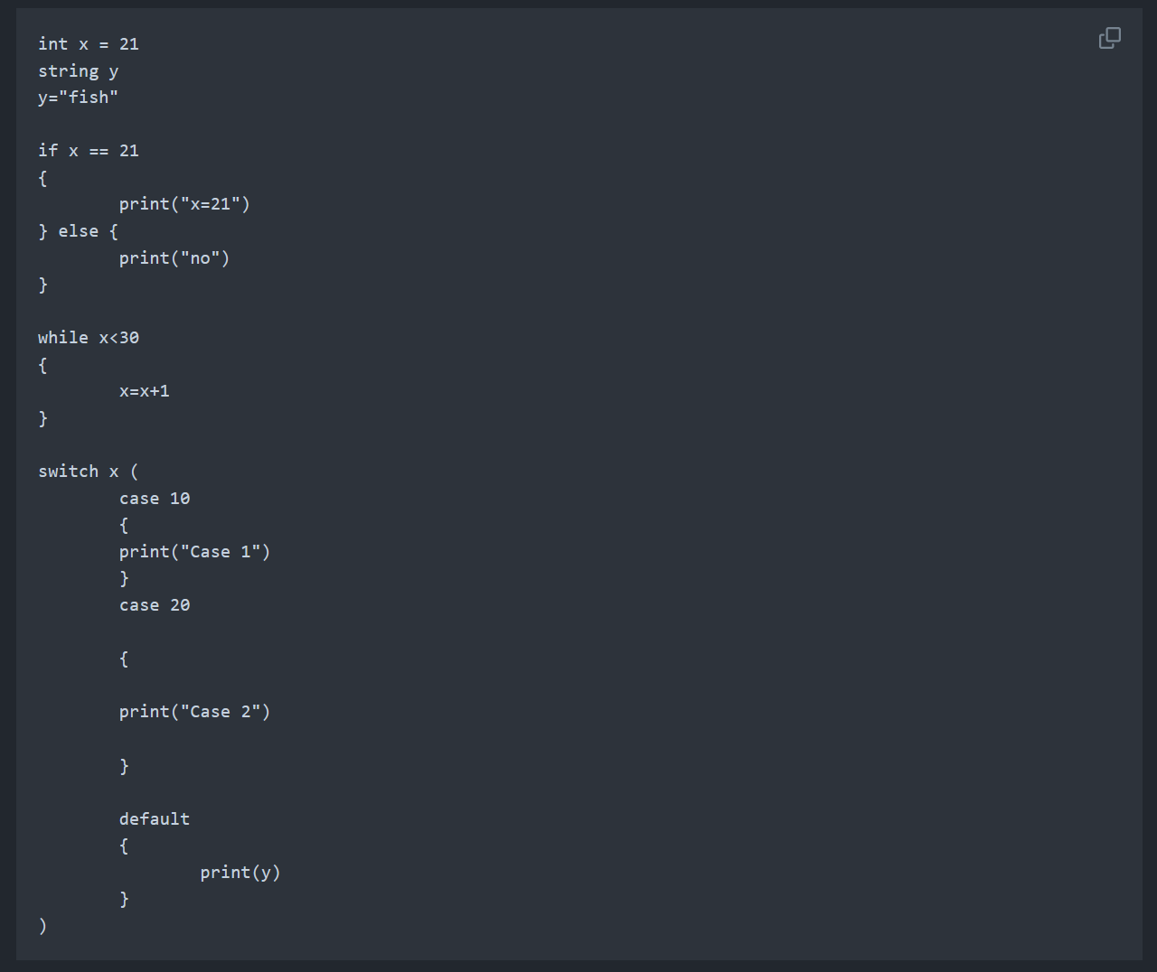
Exemplos de código

Slide 6
Exemplos de erro
int x = 1
x = “string”
int x = “string”
x = 1

